Slide 1

Emergence of Cellular Aging from Gene Networks
Hong Qin
October 8, 2013

Slide 2
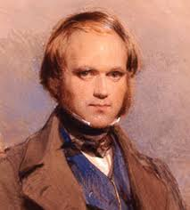
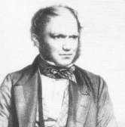
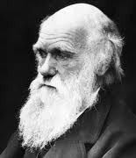




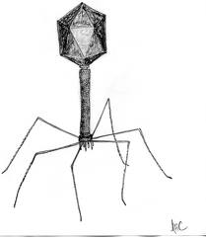

Question: What is it?
Answer: Aging
Humans do it
Birds do It
Bees do It
Yeast cells do it
Boeing airplanes do it
Computers do it
Viruses do NOT do it.
Radioactive isotopes do NOT do it.

Slide 3
The quantitative definition of aging
Aging = mortality rate increase over time
m: mortality rate
s: viability or survivorship
Notes:
Gompertz mortality model (constant hazard model)
Mortality Rate: m = - (ds/dt)(1/s) = I₀ e^{Gt}
Viability: s = exp[ (I₀ /G) ( 1 - e^{Gt}) ]

Slide 4
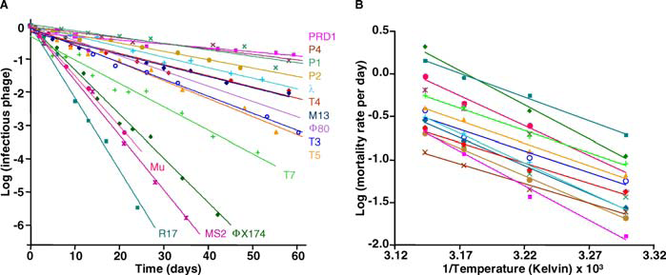
Non-aging systems
De Paepe & Taddei, 2006, Plos Biology

Slide 5
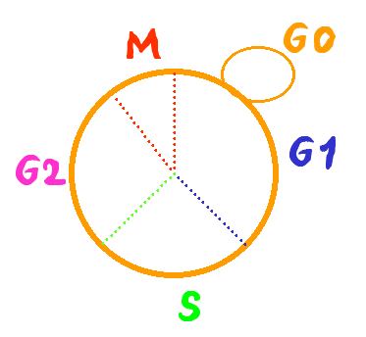
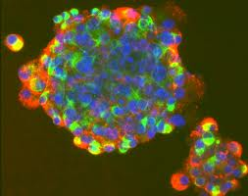
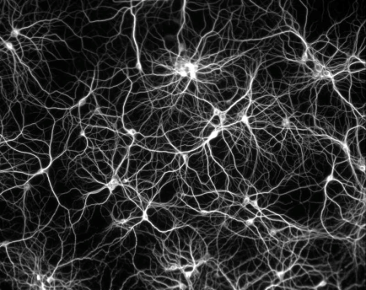
Budding yeast S. cerevisiae is a model of cellular aging
Replicative life span
The average number of offsprings of single mother cells
dividing cells
Chronological life span
The duration of cells in stationary phase
non-dividing cells
Notes:
As a cellular organism, the life span of yeast can be measured in two different ways. The RLS and the CLS.
How to assay RLS?
S. cerevisize grow by budding out new cells. The new cells are smaller than the old mother cells. This enable us to identify the mother and daughter cells under microscope and separate them by by micro dissection.

Slide 6
Assay of replicative life span in yeast
new bud
remove bud with micro-manipulator
90 min @ 30 ˚C
repeat until cells no longer reproduce

Slide 7
Assay of chronological life span in yeast
t=0
t=1day
t=5 days

Slide 8
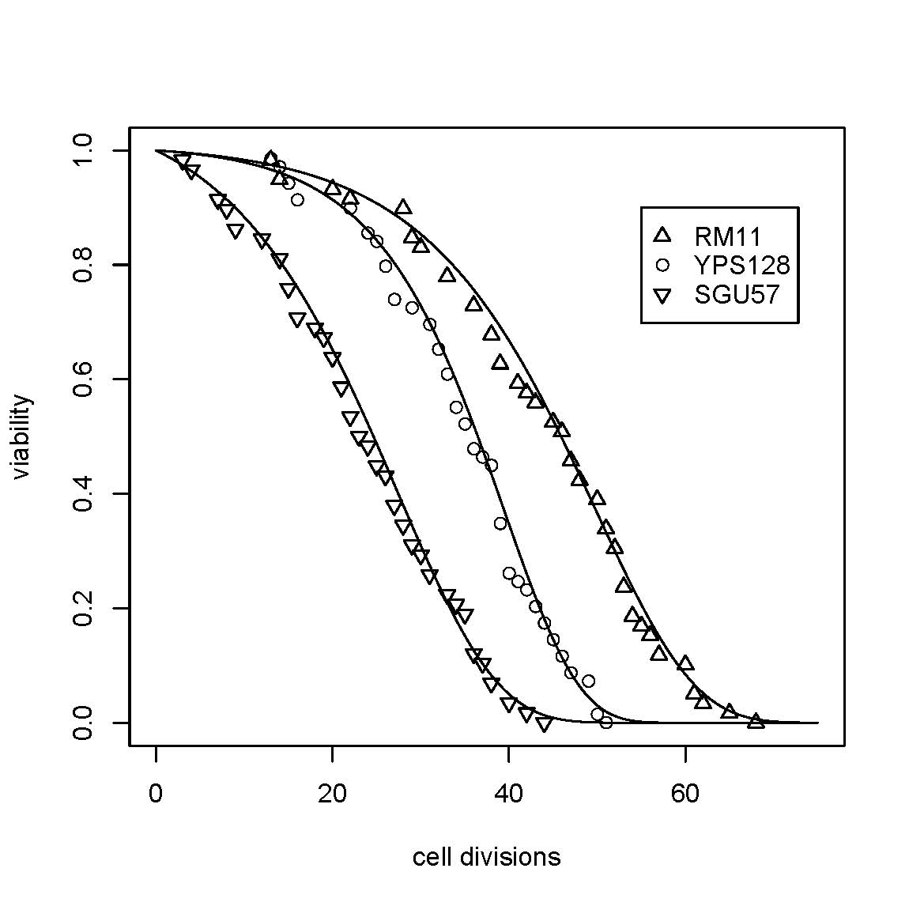
Yeast life span follows Gompertz model
Qin and Lu, 06
Exp Gerontology
Notes:
Regression of avg with group + strain

Slide 9
Gompertz definition of biological aging
Mortality rate
Viability
Aging is modeled as exponential increase of mortality rate over time.
R₀ : initial mortality rate, innate susceptibility to dying, lifespan potential at birth.
G: an coefficient for mortality rate acceleration (rate of aging)
Notes:
Gompertz mortality model (constant hazard model)
Mortality Rate: m = - (ds/dt)(1/s) = I₀ e^{Gt}
Viability: s = exp[ (I₀ /G) ( 1 - e^{Gt}) ]

Slide 10
Yeast aging is a stochastic process to a large extent.
Model 1: AGE_{ijk} ~ u + STRAIN_{i} + GROUP_{j} + PLATE_{ij} + e_{ijk}
Model 2: AGE_{ijk} ~ u + STRAIN_{i} +ζ_{j} + e_{ijk}
Model 3: AGE_{ijk} ~ u + STRAIN_{i} + e_{ijk}
Conclusion: Genotypic variation accounts for 22% of
RLS variation among individual cells.
Qin and Lu, 2006

Slide 11
A paradox in yeast aging: No aging genes.
It seems that once we delve into the molecular mechanism of aging, we lose the biology of aging. Why?
Genes with known effect on life span show no molecular mechanisms that are directly linked to aging.
SIR2
How does extra-chromosomal rDNA circles affect aging?
TOR1/2
?
Sch9
?
Notes:
Longo’s sir2 role cell paper: sir2D sch9D -> extremely long cls (However, Fig1D shows that sir2D actually has larger variance, median seems to be similar to WT in haploid background.)

Slide 12
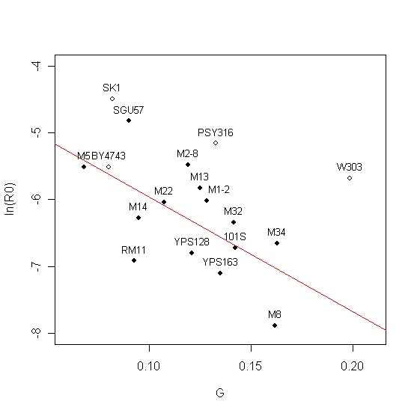
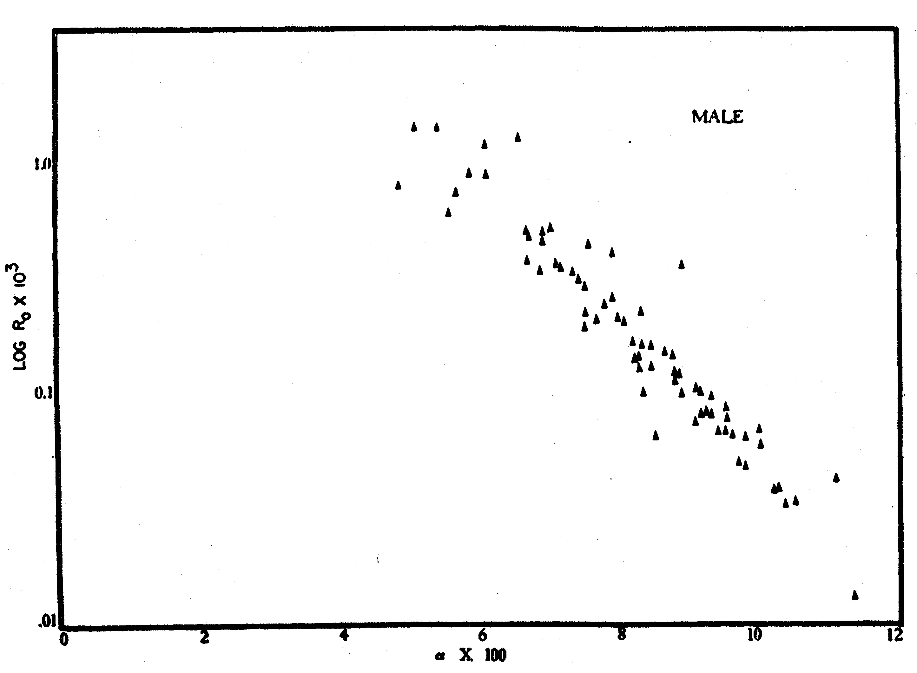
Another paradox of aging: Universal demographic characteristic of aging.
Suggesting a common principle underlying the random process of aging.
Yeast
Human
Ln(R0)
G
Qin & Lu, 2006 Exp Gerontology
Strehler & Mildvan, 1960 Science
Notes:
Regression is only done to the natural isolates (solid black dots).

Slide 13
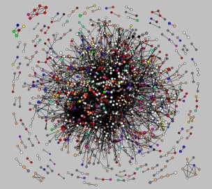
What we know about cellular aging in yeast
Largely stochastic No aging genes yet influenced by many Universal demographic characteristic
Cellular aging is an emergent property of gene networks

Slide 14


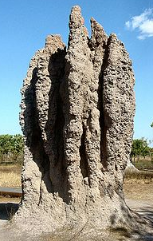
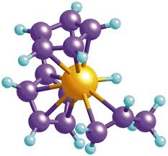
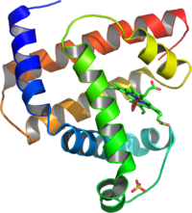
What is an emergent property?
Often loosely refers to the property arising at higher levels as a result of interaction at a low level.
A still debatable concept.
You know it when you see it.
Notes:
http://en.wikipedia.org/wiki/Emergent_property
Termite castle
Shoal of fishes

Slide 15
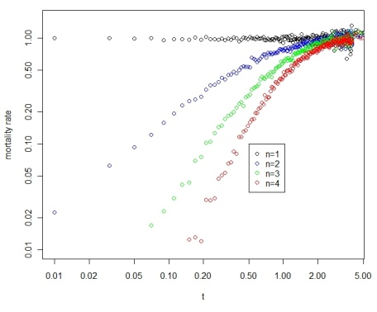
Aging can arise from systems with non-aging components
In essence, characteristics of aging of a system can arise from interactions of non-aging components, i.e., aging is an emergent property.
Gavrilov & Gavrilova, 2001 JTB
Notes:
Fig 1. Increase of mortality rate over time, a characteristic of aging, can arise in systems with parallel non-aging components. (A) A system with 4 parallel components (n=4). (B) Simulation of parallel systems with 1,2,3, and 4 non-aging components (constant aging rates).

Slide 16




Redundancy increases the latency of failure.
Robustness

Slide 17
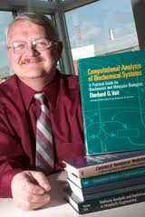
The key of modeling in biology is how to model the phenotype.
How can we model aging using networks?

Slide 18

The key phenotype for modeling aging is _____
DEATH

Slide 19
A gene/protein network model of cellular aging
Essential Node
Non-essential Nodes
An essential gene
with four connections
A reliability model
with four parallel pathways

Slide 20
Network with modules
Weibull model of Machine Aging
A network with two
essential modules
Assumption: Links between
modules do not affect aging.
A reliability model
with two modules

Slide 21
Biological Aging vs. Machine Aging: Two different families of mortality rate.
Machine Aging
Biological Aging
where m(t) is the mortality rate, s is viability, and t is time. C1, C2, ₀, G are constants. Mortality rate increase as a power function in machine aging versus a exponential function in biological aging .
(Garilov & Gavilova 2001)

Slide 22

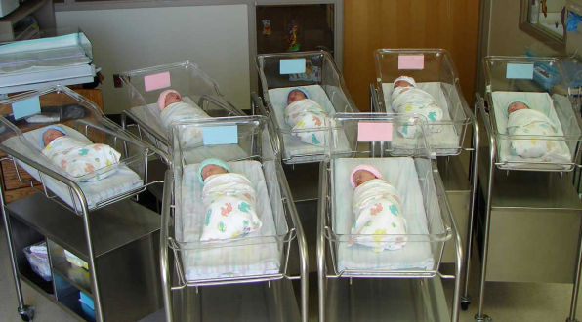
What are the differences between mass-produced machines and the thousands of babies born on one day?
Homogeneous
Systems
Heterogeneous
Systems

Slide 23
Modular networks with stochastic links
Cell-1
Rationale for stochastic links
Cellular process is a dynamic process
Limited number of protein molecules and the stereo-hindrance effect.
Spatial restrictions
Random choices
Cell-2
Cell-3

Slide 24
Modular network with stochastic links
Gompertz Aging, i.e. Biological Aging
p
p
p
p
p
Modular network with
stochastic links
p
p
p
p
p
A reliability model
with stochastic defects
p
p
p
p
p
p
m: the number of modules
n: the number of links per essential gene (essential module)
k: exponential decay rate (constant aging rate)
p: the chance of a link to be active ( p = avg func links/ n)
c: a normalization constant

Slide 25
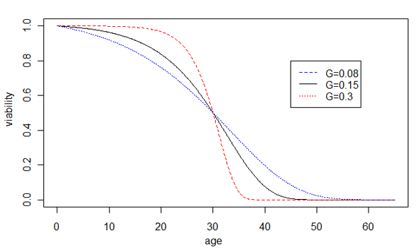
Prediction of the network model of cellular aging
Increased robustness
Decreased robustness
Notes:
Prediction of our hypothesis, the effect of network robustness on the rate of aging G, is shown by changes of the Gompertz survival curves. Increased robustness leads to larger G and faster aging, shown by the sharper transition of the dying off phase, whereas decreased robustness leads to smaller G and slower aging, shown by the slower dying off phase. For illustration purposes, the average life spans are unchanged.

Slide 26
Which groups of people would pass-away at a faster rate, i.e., age faster?
1) Normal people
2) Centenarians
Average lifespan of US citizens is 79 yr old.
The current world’s oldest living person is 122.5 yr old.
It is counter-intuitive because colloquial usage of aging contains information for both Gompertz parameters.

Slide 27
Active number of interactions, np, influence R0 and G
R₀
G
p
p
Notes:
For my Tg/C results, R0 is negatively correlated. But G is not significantly correlated in partial regression. I need more data. So Kaberlein’s data is really a geneous gift to me. I can measure the oxidative tolerance of these strains, or mutational tolerance Tg/Tc of these strains.

Slide 28
Changes of network configuration can lead to the Strehler-Mildvan correlation.
Wild isolates
Long-lived deletions

Slide 29
Empirical evidences that support our network model.
Aging in diploid and haploid cells.
Genomic instability
Oxidative stress and lifespan.

Slide 30
Robustness and the amount of molecules
Diploid cells are generally more robust than haploid cells. If we assume the number of molecules to perform a biological function follows a binomial distribution with a probability of p and are drawn from n number of molecules, coefficient of variation (CV) can be calculated from standard deviation divided by mean: .
Doubling the numbers of molecules should reduce noises by and hence increase robustness, as argued by Schrödinger in 1944. Yeast protein expression noises in G1 phase are much lower in diploids than that of haploid cells.

Slide 31
Testing the model: Diploid cells age faster than haploid cells
Table Aging rate is faster in diploid BY4743 than in haploid strains based on nest model tests.
Models | lnL
H0 R_{BY4741} = R_{BY4742} = R_{BY4743}, G_{BY4741}= G_{BY4742}= G_{BY4743} | -952.7
H1_{g2} R_{BY4741} = R_{BY4742} = R_{BY4743}, G_{BY4741}= G_{BY4742}≠G_{BY4743} | -946.1
H1_{i2} R_{BY4741} = R_{BY4742} ≠R_{BY4743}, G_{BY4741}= G_{BY4742} = G_{BY4743} | -939.4
H2_{ig2} R_{BY4741} = R_{BY4742} ≠ R_{BY4743}, G_{BY4741}= G_{BY4742}≠G_{BY4743} | -937.2
H3_{i3ig2} R_{BY4741}≠ R_{BY4742}≠ R_{BY4743}, G_{BY4741}= G_{BY4742}≠G_{BY4743} | -929.3 | Best parsimonious model p-value=3.6x10⁻¹⁰ (chi-square, df=3) G_{BY4741}= G_{BY4742} = 0.0653 G_{BY4743} = 0.0786
H6 R_{BY4741}≠R_{BY4742}≠R_{BY4743}, G_{BY4741}≠G_{BY4742}≠G_{BY4743} | -929.3

Slide 32
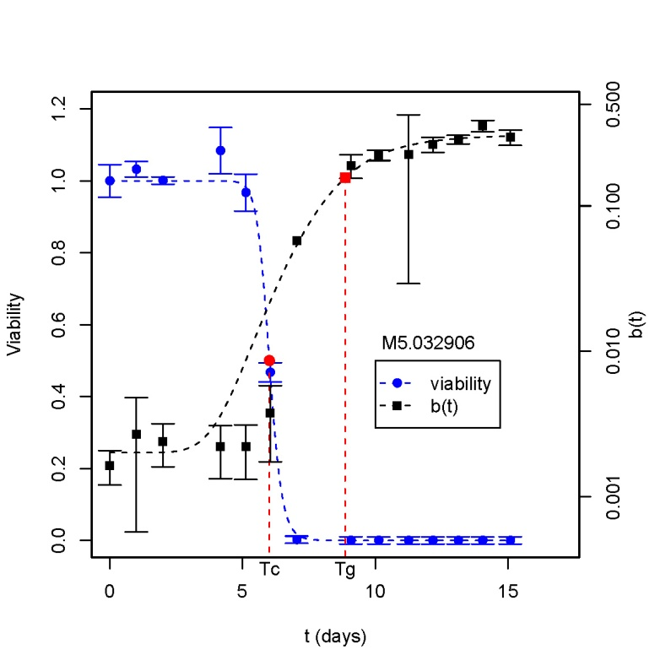
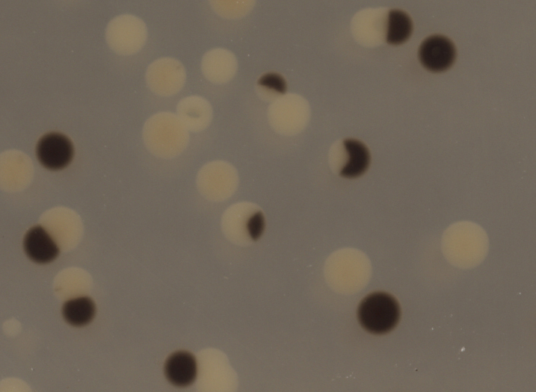
Tolerance to genomic instability accounts for 30-50% replicative life span variation among strains.
Tg
Tg/Tc
Tc
ARLS
Qin et al, 2008

Slide 33
Trade-off between RLS and tolerance to H₂O₂ induced genomic instability.

Slide 34
Summary (Take-home messages)
Cellular aging emerges from gene networks.
Heterogeneity and stochasticity are key factors in biological aging
Aging is our best measure of robustness.
Gompertz coefficient G is a proxy of robustness.

Slide 35
On-going studies and half-baked ideas
Power-law network configuration
A general framework for limiting network modules on lifespan.
Limiting interaction modules
Use empirical network to fit experimental lifespan data
Synthetic lethality
Quantitative genetics and missing heritability.

Slide 36
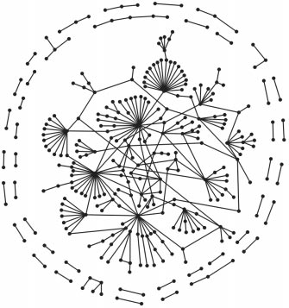
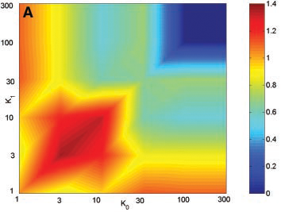
Network configuration, error tolerance , and aging dynamics.
Power-law
Degree1
Degree0
Barabasi & Oltvai 2004 Nature Review Genetics
Malov & Sneppen 2002 Science

Slide 37
Network configuration
Degree distribution on network aging
A_{e,n}
Nonessential Genes
1 0 1 1 0 0 . . .
2 1 0 0 0 0 . . .
. . . . . . . . .
i 1 0 1 1 0 . . .
. . . . . . . . .
Individual renewal/repair
vs modular renewal/repair
Essential Genes
?
Degree distributions
Power-law
?
Network reliability
and aging
e_{i,j} are the elements of the adjacency matrix.
e_{i,j} =1 means interaction between i-th essential gene and j-th nonessential gene.
e_{i,j} = 0 means no interaction.
Exponential
Constant
(Basic version)
Degree of i-th essential gene:

Slide 38
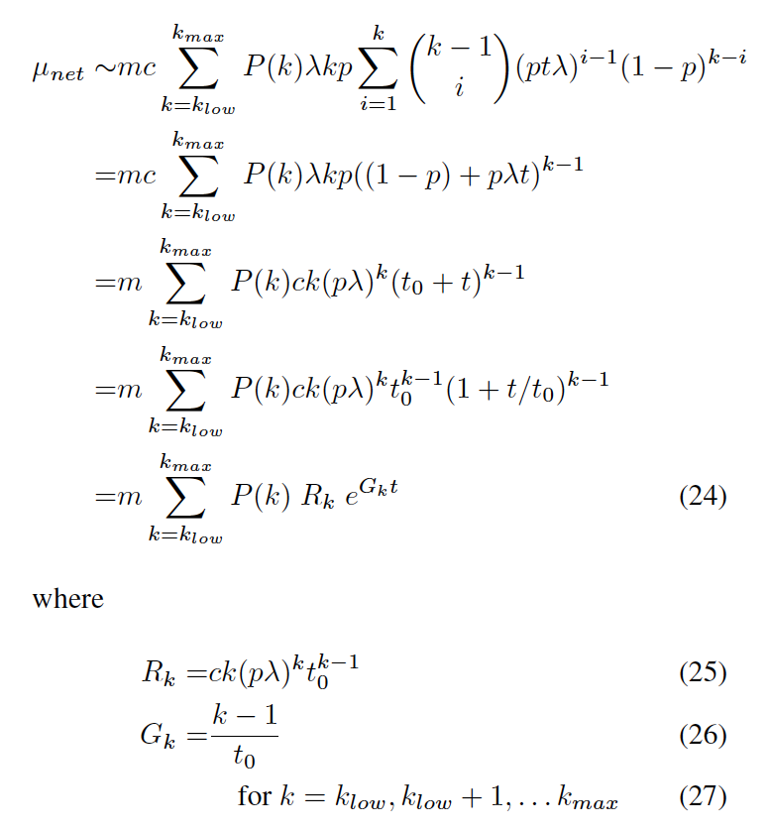
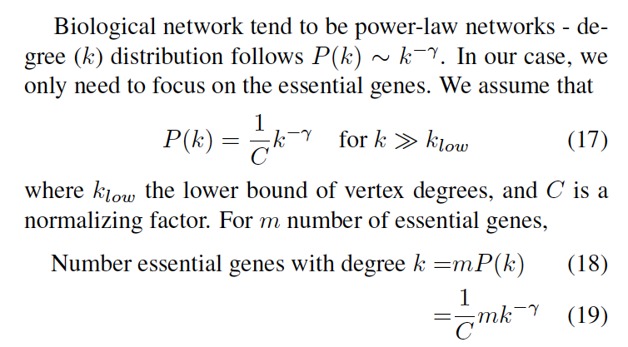
Preliminary results of power-law effect on aging
Notes:
The normalization ‘c’ is a variable of p and n, and should be inside of the summation part at the first step.

Slide 39
A general framework to study limiting network modules on viability-related phenotypes.
(A) Gene Network
(B) Reliability Model
(C) Equivalent Path Models
Y
Parallel
y1, y2, y3, …
X
Subnetwork Y
Y
Serial
Y
X
X
x1, x2, x3, …
Y
Mixture
Subnetwork X
X
Y
X

Slide 40
Using the yeast protein interaction network to evaluate interventions on aging.
Yeast wildtype lifespans
BY4742, BY4741, BY4743, … …
Wildtype global parameters
Approximation to
narrow parameter space
Bulk of network Y
M1: Fixed R_{y} G_{y}
M2: Protein Network with λ_{y} p_{y}
Mutant mechanistic parameters
M1: n_{x} λ_{x} p_{x} φ
M2: more parameters
Limiting Module X
n_{x} λ_{x} p_{x} φ
Minimizing RSS
AIC=N ln(RSS/N)+2K
M2
M1
M1 or M2?
Approximation
Consistent?
Mutants sir2Δ tor1Δ or compounds.
Mutant global parameters
Notes:
I can add synthetic lethal pairs into the model.

Slide 41
Synthetic lethality and network aging.
Reliability aging model of a synthetic lethal pair X and Y
Wildtype
Deletion of Y (genotype y∆)
Deletion of X (genotype x∆)
X
Z
Z
X
Z
Y
Y
Z represents the rest of the network.

Slide 42
Network aging as a quantitative trait and implications on missing heritability.
Two independent loci X and Y
X1
Y1
Z
X2
Y2
Network Aging Model
Missing
Heritability?
Linear Model
Notes:
The product viability forms can be used to evaluate whether two loci are independent or not.

Slide 43















Acknowledgement
David Goldfarb
Meng Lu
François Taddei
Ariel Lindner
Tamara Milosevic
Ming Ni
Matt Kaeberlein
Brian Kennedy
John Tyson
Chun Chen
Greg Smith
CSHL Computation Cell Biology course
Lou Gross
NSF
Spelman College
Over 40 Spelman
students
Maxine Linial
Katie Peichel
Suzannah Rutherford
Antonio Bedalov
Dan Gottschling
David Botstein
Alison Gammie
Sandy Silverman
Justin Fay
Jeffrey Townsend

Slide 47
Changes of network configuration can cause the Strehler-Mildvan correlation in wild yeast isolates.

Slide 48
BY deletion mutants

Slide 49
Influence of robustness on lifespan
Genetic robustness
Mutational robustness
Genetic interactions
Phenotypic robustness
Fitness at various growth conditions
Morphological robustness
Stochastic expression variations

Slide 50
Future directions
Renewal and repairs
Cooperative interactions
Synthetic lethality
Related to network error-tolenrance
Allelic interactions
Natural variation
Missing heritability
Dominance, canalization
Evolution in age-structured populations
Antibiotic persistence
Network based speciation model.

Slide 51
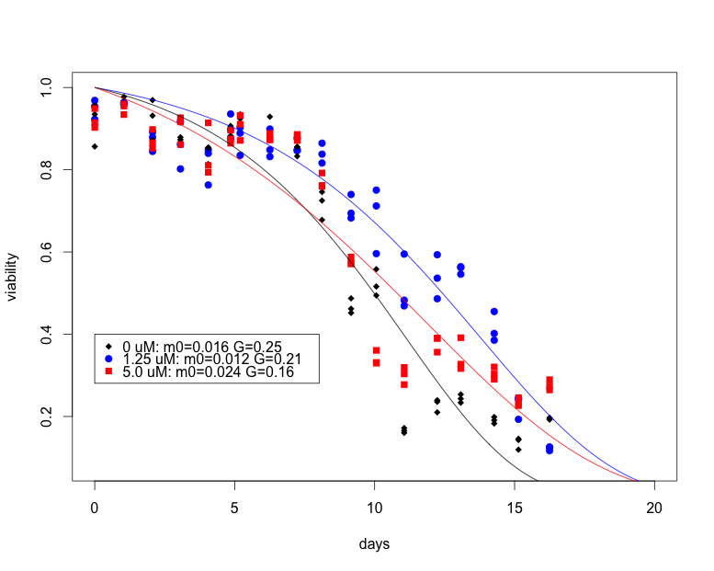
Reducing robustness by inhibition of hsp90 using radicicol lead to smaller G.
Good news: Life span extension
Bad news: It kills 5% of the population

Slide 52
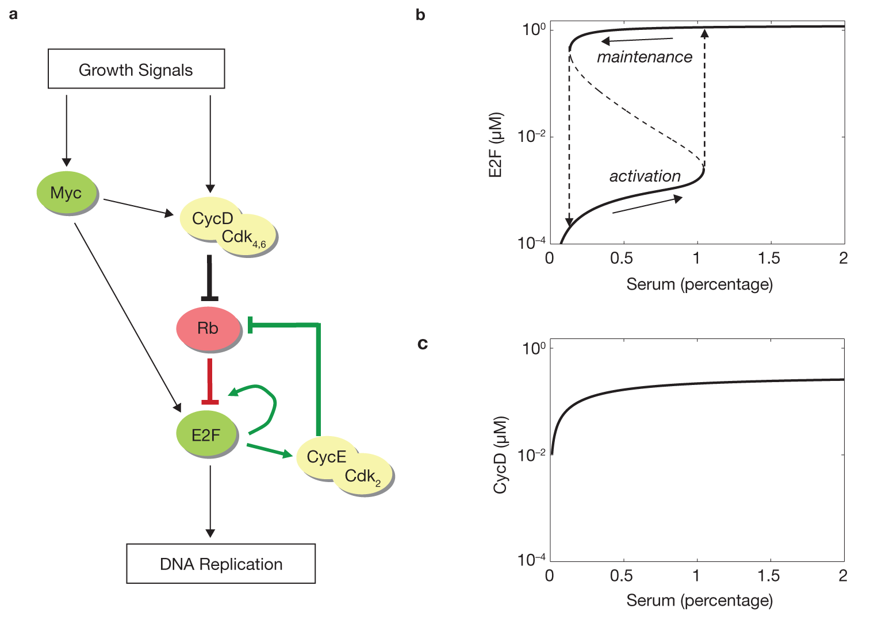
The Rb-E2F bistable switch in G1/S check point
Yao et al , 2008 Nature Cel Biol

Slide 53
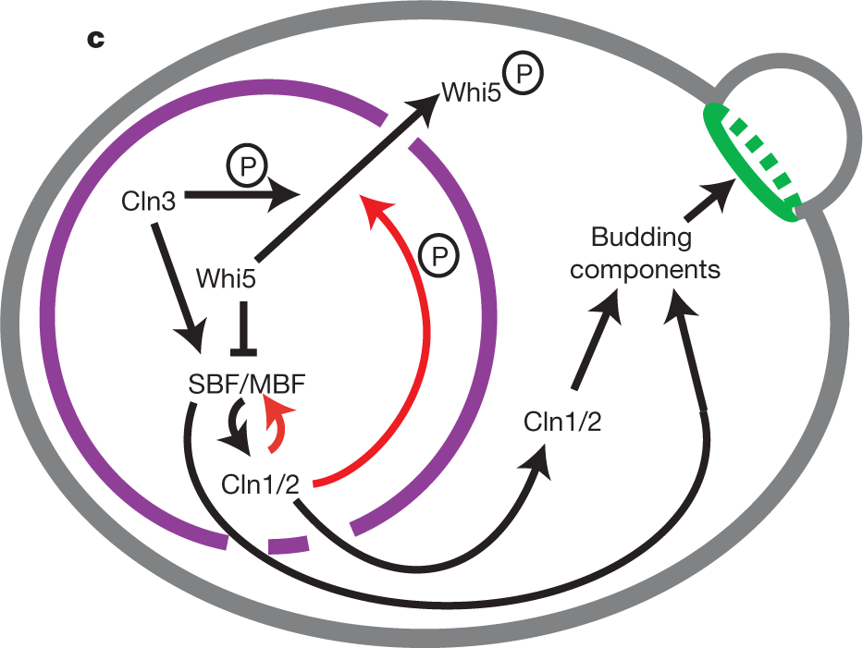
The Rb-E2F switch is conserved in yeast.
CLN3
(CycD)
WHI5
(Rb)
SBF
(E2F)
Growth
Quiescence:
Arrest in poor growth conditions
Senescence:
Arrest in good growth conditions
Skotheim , 2008 Nature

Slide 54
A non-proliferation model of cellular aging based on G1/S check point.
CLN3
(CycD)
WHI5
(Rb)
SBF
(E2F)
Growth
Aging effect
Senescence: arrest in good growth conditions
Quiescence: arrest in the poor growth conditions
Notes:
WHI5 (Rb) initially should be high to inhibit SBF (Yao 08, Nature Cell Biology). When growth triggers CLN3, CLN3 will quickly phosphorylate whi5 and move it to cytosol.
Aging will slow down nuclear-cytol traffic.
SBF autoregulates itsself through Cln1/2(CycE)

Slide 55
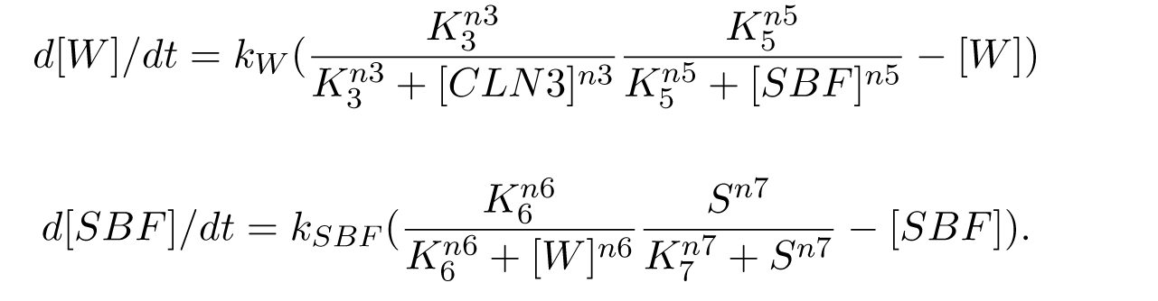
A simple model on G1/S check point.
CLN3
(CycD)
WHI5
(Rb)
SBF
(E2F)
Growth
Notes:
WHI5 (Rb) initially should be high to inhibit SBF (Yao 08, Nature Cell Biology). When growth triggers CLN3, CLN3 will quickly phosphorylate whi5 and move it to cytosol.
Aging will slow down nuclear-cytol traffic.
SBF autoregulates itsself through Cln1/2(CycE)

Slide 56
Uniform sampling of
parameter space and initial conditions
Select parameter sets with bistable [SBF]ss
K5, n5, K6, n6
Bifurcation analysis

Slide 57
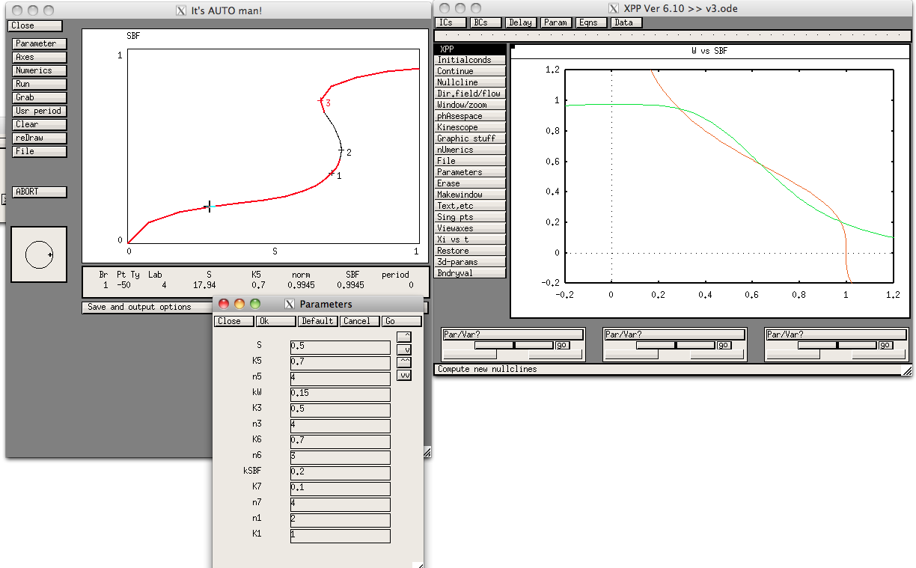
Bifurcation and phase diagrams
stable
unstable

Slide 58
To do: Parameter sensitivity analysis Incorporating nutrient sensing pathways Incorporating aging effect
K7,n7
CLN3
(CycD)
WHI5
(Rb)
K6,n6
SBF
(E2F)
Growth
K3,n3
K5,n5
TORC1
MSN2/4
Aging effect?
Mitochondrion
OTHERS?
Notes:
WHI5 (Rb) initially should be high to inhibit SBF (Yao 08, Nature Cell Biology). When growth triggers CLN3, CLN3 will quickly phosphorylate whi5 and move it to cytosol.
Aging will slow down nuclear-cytol traffic.
SBF autoregulates itsself through Cln1/2(CycE)

Slide 59
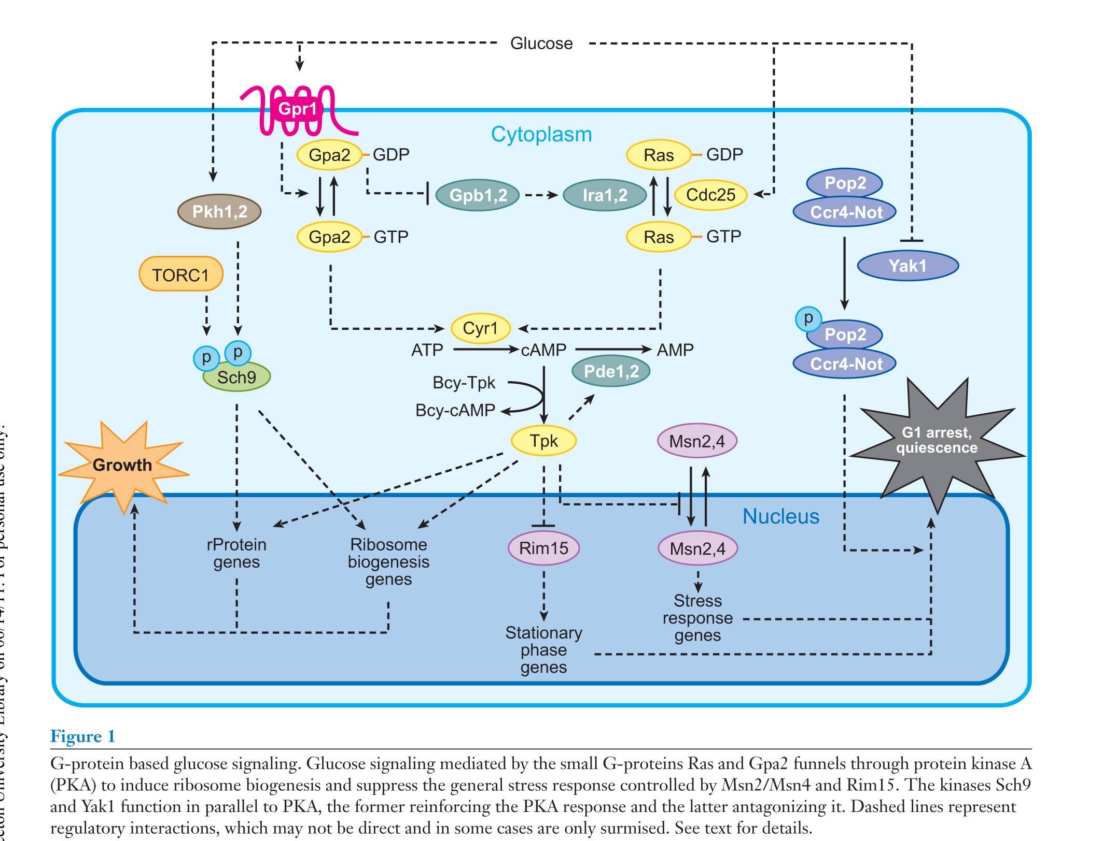
Nutrient sensing and quiescence (Zaman et al, 2008, ARG)

Slide 60
Calorie restriction and aging
CR is the most effective way to extend lifespan.
CR increases intracellular trehalose.

Slide 61
Thank you! May robust gene interactions be with you all the time.

Slide 65
A general theoretic framework for cellular aging
Cellular aging is an emergent property of gene networks.

Slide 66

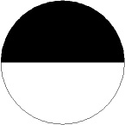

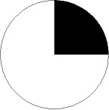
Detection of aged-dependent change of genomic instability in yeast aging: Loss of heterozygosity at the MET15 locus
Cells in water
Transfer to plates
No LOH
MET15^{+/-}
MET15^{+/+}
Mother Cells
LOH
met15^{-/-}
First mitosis
Single LOH
Second mitosis
1st generation
Single LOH
1st + 2nd generation
2nd generation
Notes:
During aging, there is accumulation of oxidative damages in mother cells. Mother cells tend to keep these damages within themselves. Ideally, daughter cells should be born free of damages. Hence, the partition of cellular components is asymmetric.
The ratio of half blacks over full blacks measure how much oxidative damages are passed to the next generation.
This direction is related to DNA repair pathways.

Slide 67
Morphological robustness CV ~ RLS, CLS?

Slide 68
Some implications of cellular aging as an emergent property of networks.
Trade off between R0 and G (negative correlation between lnR0 and G).
There is no real “aging” genes.
Ageing is influenced but not controlled by genes, Kirkwood &Finch 2002, Nature.
We should pay more attention to gene interactions and their temporal dynamics.
Heterogeneity and stochasticity are important features of life.
Notes:
How about SIR2, shc9, ros1, hxk, fob1?
Laboratory strain BY4743 show smaller Gompertz coefficient than wild isolates, especially for CLS.

Slide 69
Implications of the network aging model (conti’d)
Theoretic perspectives
Power-law networks versus random networks
Connection between aging and genetic capacitors
Heterogeneous rates of exponential decays
Empirical perspectives
G as a proxy of robustness (a phenotypic measure).
Provides a new perspective to interpret experimental data.
Provides a different perspective on interpreting GWA on life-history traits.

Slide 70
Antagonistic pleiotropy theory of aging
Network-based models will put pleiotropy model on a mechanistic foundation.
Williams 1957
Trade-off
Early benefits and late costs
Pleiotropy
Gene interactions
Influenced by network temporal dynamics

Slide 71
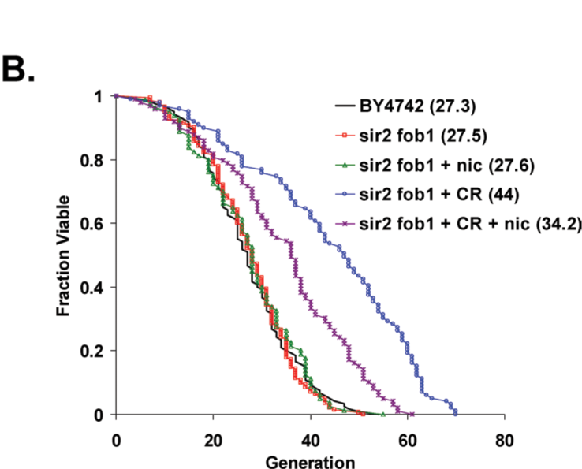
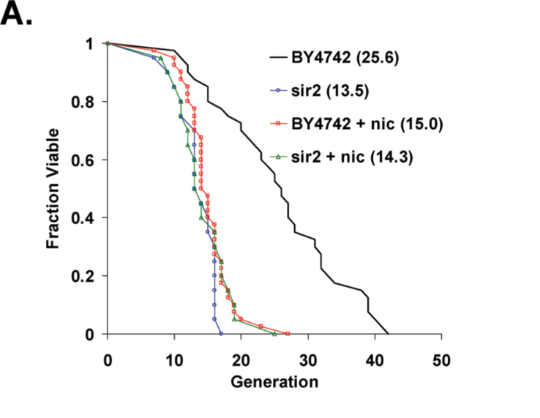
SIR2 deletion: Overloaded gene network?
Kaeberlein et al 2006, PlosGenetics
Notes:
Overexpression of genes leads to over-loaded gene network?
Verify by GFP, stochasticty in sir2D mutants?

Slide 72
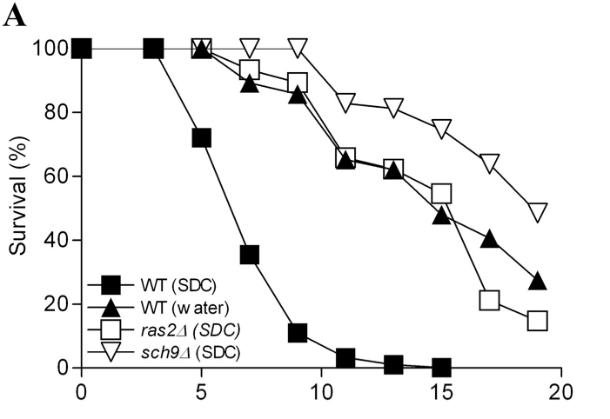
Sch9 seems to influence the Gompertz coefficient.
Fabrizio et al 2004, JBC

Slide 73
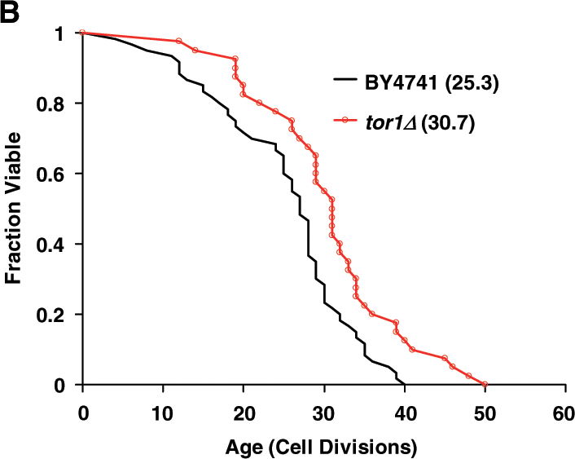
TOR1 seems to influence the initial mortality rate.
Kaeberlein et al, 2005 Science

Slide 74
Prediction of the network model of cellular aging
Increased robustness
Decreased robustness
Notes:
Prediction of our hypothesis, the effect of network robustness on the rate of aging G, is shown by changes of the Gompertz survival curves. Increased robustness leads to larger G and faster aging, shown by the sharper transition of the dying off phase, whereas decreased robustness leads to smaller G and slower aging, shown by the slower dying off phase. For illustration purposes, the average life spans are unchanged.

Slide 75
Outline
Introduction on cellular aging A reliability model of cellular aging based on stochastic gene networks Experimental tests of the reliability model A nonproliferation model of cellular aging based on G1/S check point.

Slide 76
Testing the model: Diploid cells age faster than haploid cells
Table Aging rate is faster in diploid BY4743 than in haploid strains based on nest model tests.
Models | lnL
H0 R_{BY4741} = R_{BY4742} = R_{BY4743}, G_{BY4741}= G_{BY4742}= G_{BY4743} | -952.7
H1_{g2} R_{BY4741} = R_{BY4742} = R_{BY4743}, G_{BY4741}= G_{BY4742}≠G_{BY4743} | -946.1
H1_{i2} R_{BY4741} = R_{BY4742} ≠R_{BY4743}, G_{BY4741}= G_{BY4742} = G_{BY4743} | -939.4
H2_{ig2} R_{BY4741} = R_{BY4742} ≠ R_{BY4743}, G_{BY4741}= G_{BY4742}≠G_{BY4743} | -937.2
H3_{i3ig2} R_{BY4741}≠ R_{BY4742}≠ R_{BY4743}, G_{BY4741}= G_{BY4742}≠G_{BY4743} | -929.3 | Best parsimonious model p-value=3.6x10⁻¹⁰ (chi-square, df=3) G_{BY4741}= G_{BY4742} = 0.0653 G_{BY4743} = 0.0786
H6 R_{BY4741}≠R_{BY4742}≠R_{BY4743}, G_{BY4741}≠G_{BY4742}≠G_{BY4743} | -929.3

Slide 77
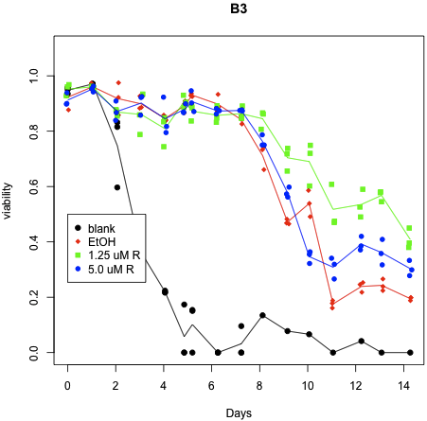
Testing the model: The effect of radicicol on chronological aging
P-value = 0.027
Increased robustness
Decreased robustness

Slide 78
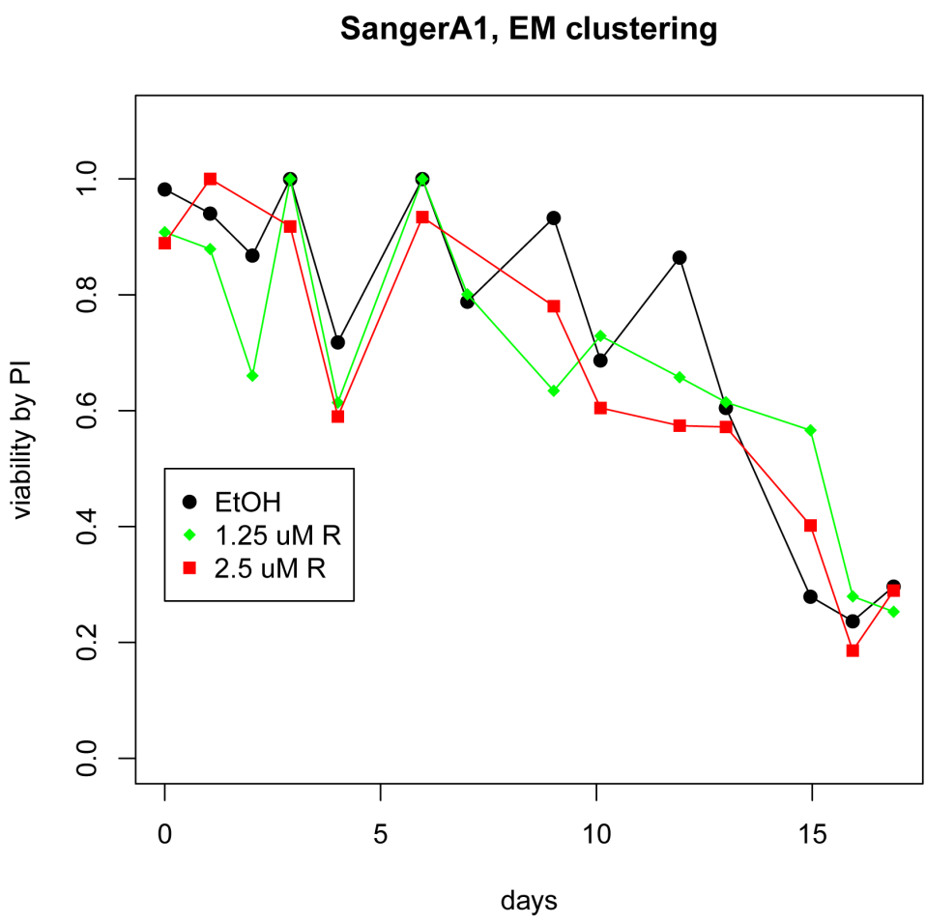
Effect of radicicol on chronological aging (cont’d)
Increased robustness
Decreased robustness

Slide 79
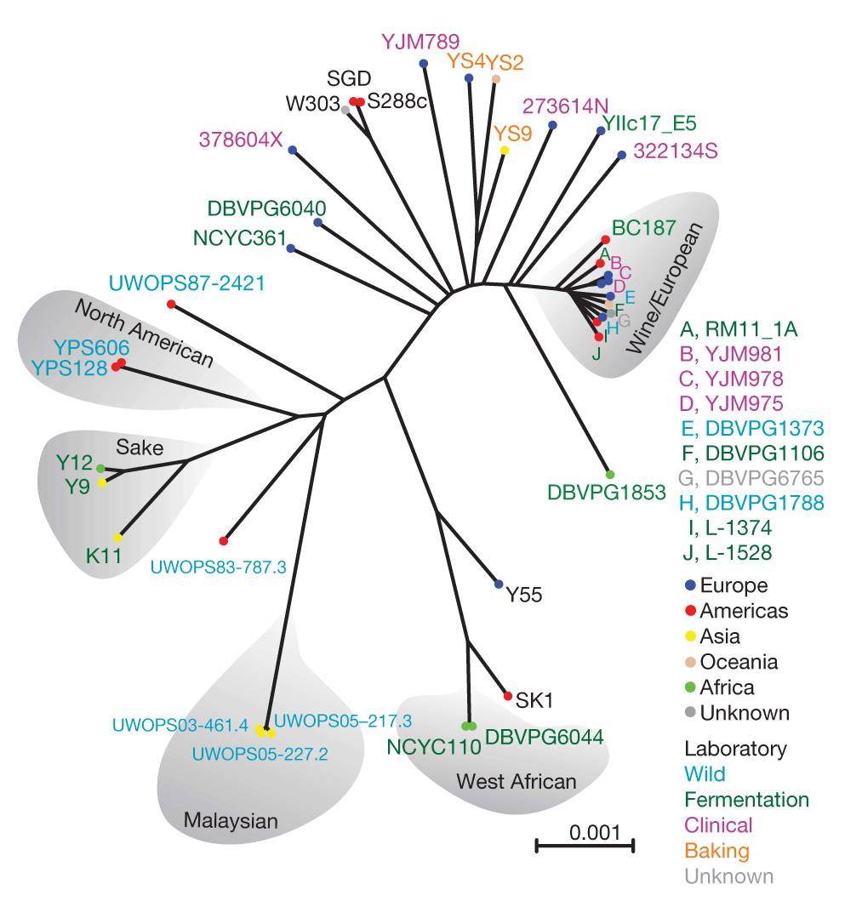
Search for loci associated with lifespan in sequenced strains.
Liti et al 2009 Nature

Slide 80
Preliminary results of GWAS on CLS
Sequenced Sanger Strains
(200K SNPs)
Focus on chr01 & 02
Look for SNP clusters
in 1Kb distance
CLS by PI and Flow Cytometry
Partition strains to short, average, long-lived groups
68 clusters
Visually check several relatively large clusters
Fisher’s exact test
(pop structure is ignored)
37K SNPs with q<=0.1
ncDNA, FLO9, PRM9, MAL31

Slide 81
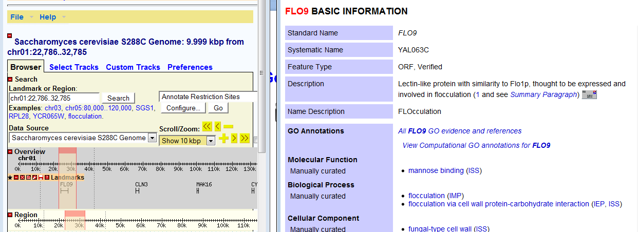
FLO9 and its 5’UTR is a major cluster

Slide 82
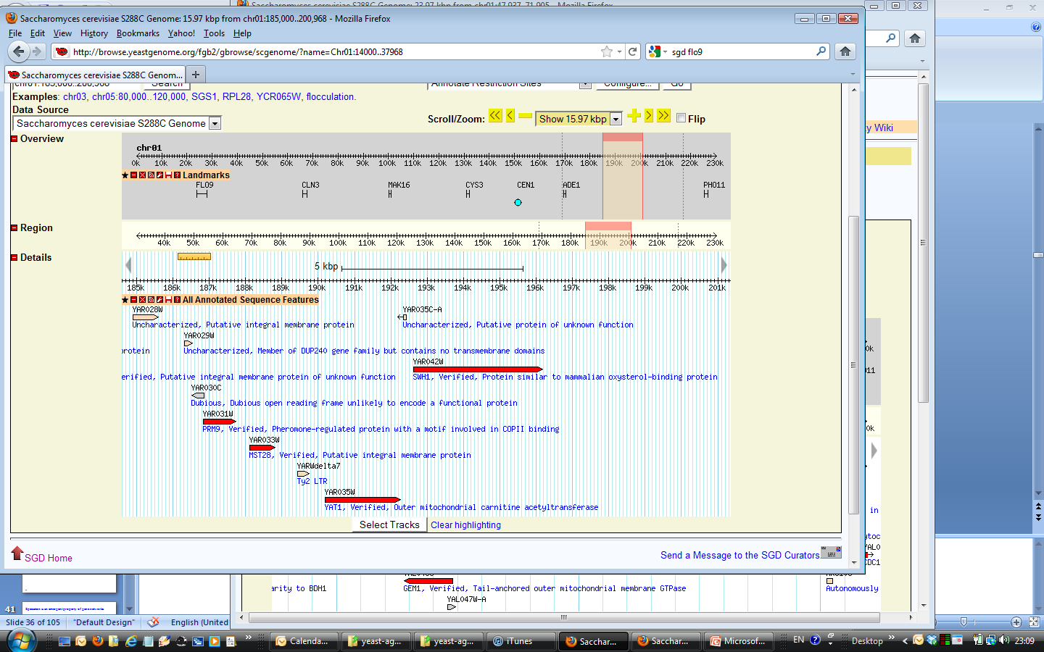
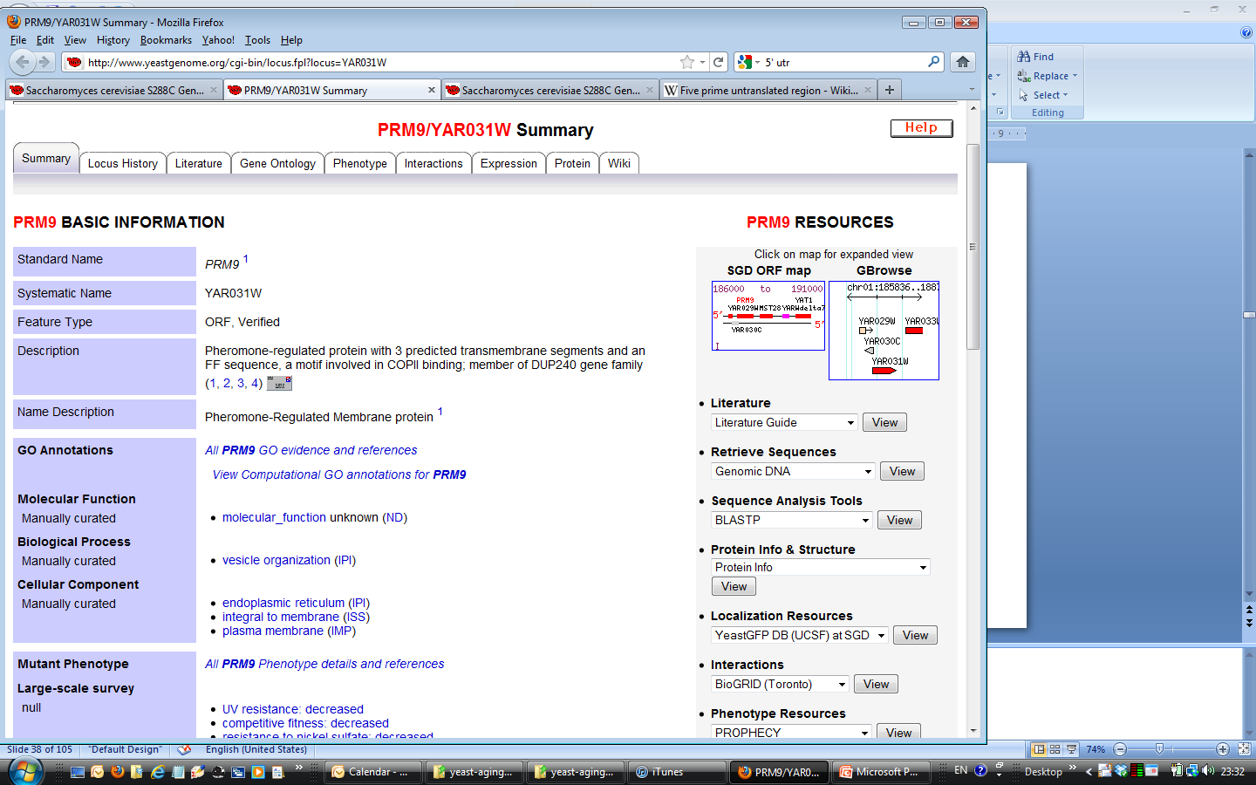
PRM9 and 3’UTR

Slide 83
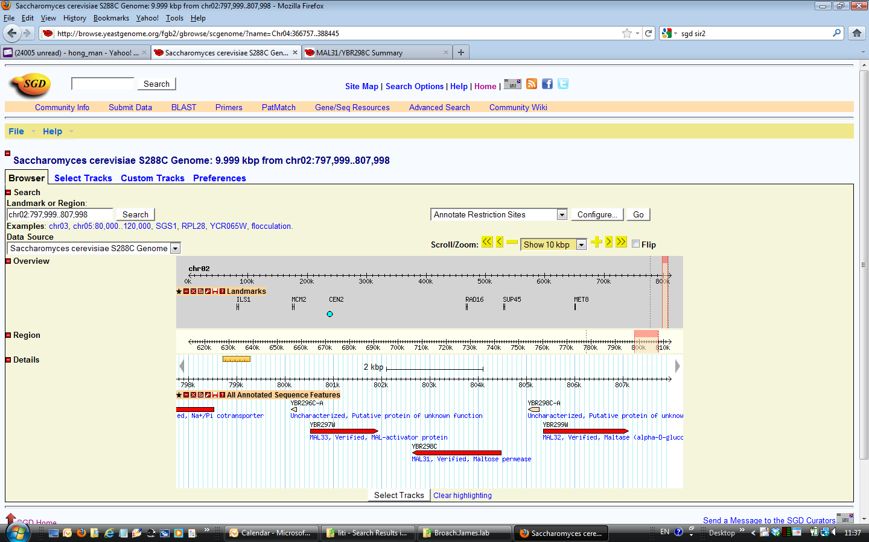
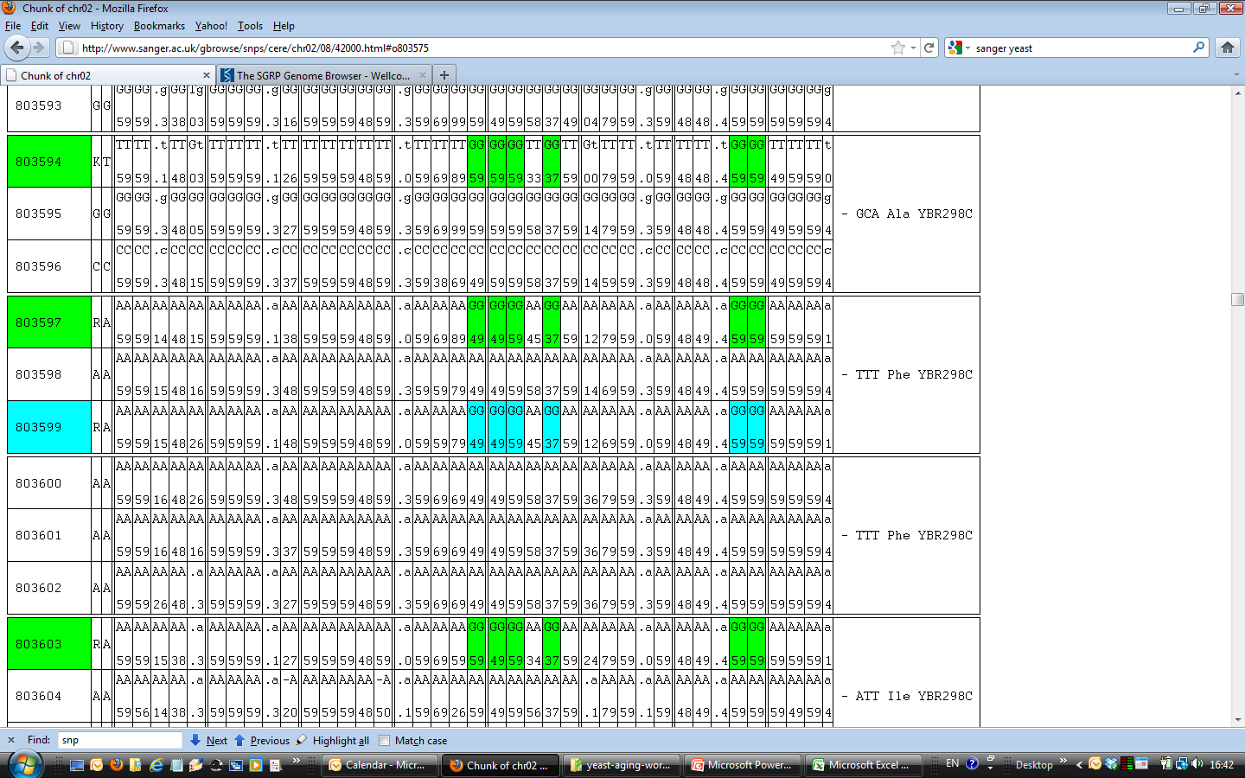
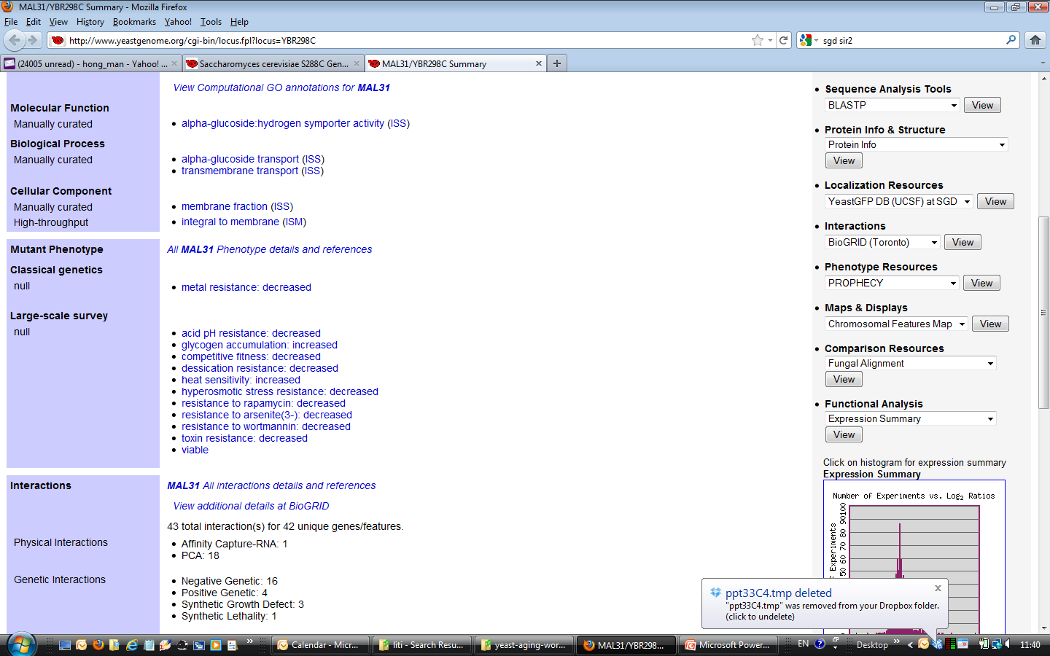
MAL31
Long lived strains have
many nonsynonymous substitutions.

Slide 84
Outline
Introduction on cellular aging A reliability model of cellular aging based on stochastic gene networks Experimental tests of the reliability model A nonproliferation model of cellular aging based on G1/S check point.

Slide 85

Acknowledgement
David Goldfarb
Meng Lu
François Taddei
Ariel Lindner
Tamara Milosevic
Ming Ni
Matt Kaberlein
Brian Kennedy
John Tyson
Chun Chen
Jeffrey Townsend
CSHL CCB course
Shyla Hardwick
Janella Wynter
Erin Jackson
David Botesin
Alison Gammie
Sandy Silverman
Tina DeCoste
Maxine Linial
Katie Peichel
Suzannah Rutherford
Antonio Bedalov
Dan Gottschling
Justin Fay

Slide 86
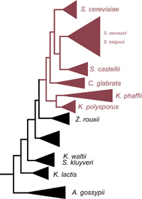
Whole genome duplication in yeasts

Slide 87
Some implications of cellular aging as an emergent property of networks.
Trade off between R0 and G (negative correlation between lnR0 and G).
There is no real “aging” genes.
Ageing is influenced but not controlled by genes, Kirkwood &Finch 2002, Nature.
We should pay more attention to gene interactions and their temporal dynamics.
Can a gene’s effect on the Gompertzian parameters be predicted by its network-related features?
Number of links of essential modules → rate of aging ?
Genes with overall effect on network → initial mortality rate.
Notes:
How about SIR2, shc9, ros1, hxk, fob1?
Laboratory strain BY4743 show smaller Gompertz coefficient than wild isolates, especially for CLS.

Slide 88
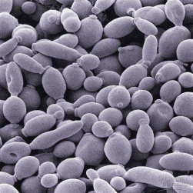
Human, flies, yeast cells, stem cells, viruses, radioactive isotopes.

Slide 89
A quantitative definition of (cellular) aging.
Gompertz model

Slide 90
Another paradox in yeast aging: Universality.
Universal demographic characteristics of aging despite the diverse genetic and environmental factors involved.
This universality suggests a common principle underlying the random process of aging.

Slide 91
Non-aging systems
De Paepe & Taddei, 2006, Plos Biology

